Slide 1
IT2060/IE2061
Operating Systems and System Administration
Lecture 04
Introduction to Threads
U. U. Samantha Rajapaksha
M.Sc.in IT, B.Sc.(Engineering) University of Moratuwa
Senior Lecturer SLIIT
Samantha.r@slit.lk

Slide 2
Motivation
Most modern applications are multithreaded
Threads run within application
Multiple tasks with the application can be implemented by separate threads
Update display
Fetch data
Spell checking
Answer a network request
Process creation is heavy-weight while thread creation is light-weight
Can simplify code, increase efficiency
Kernels are generally multithreaded

Slide 3
Threads
A thread of control is an independent sequence of execution of program code in a process.
A thread (or lightweight process) is a basic unit of CPU utilization.
A traditional process (or heavyweight process) is equal to a task with one thread.
A traditional process has a single thread that has sole possession of the process’s memory and other resources → context switch becomes performance bottleneck
Threads are used to avoid the bottleneck.
Threads share all the process’s memory, and other resources.
Threads within a process:
are generally invisible from outside the process.
are scheduled and executed independently in the same way as different single-threaded processes.
On a multiprocessor, different threads may execute on different processors
On a uni-processor, threads may interleave their execution arbitrarily.

Slide 4
Threads (cont.)
Threads operate, in many respects, in the same manner as processes:
Threads can be in one of several states: ready, blocked, running, or terminated, etc.
Threads share CPU; only one thread at a time is running.
A thread within a process executes sequentially, and each thread has its own PC and Stack.
Thread can create child threads, can block waiting for system calls to complete
if one thread is blocked, another can run.
One major different with process: threads are not independent of one another
all threads can access every address in the task → a thread can read or write any other thread’s stack.
There is no protection between threads (within a process);
however this should not be necessary since processes may originate from different users and may hostile to one another while threads (within a process) should be designed (by same programmer) to assist one another.

Slide 5
Threads (cont.)
Three processes with one thread each
Process
Thread
PC
One process with three threads

Slide 6
Benefits
Responsiveness – may allow continued execution if part of process is blocked, especially important for user interfaces
Resource Sharing – threads share resources of process, easier than shared memory or message passing
Economy – cheaper than process creation, thread switching lower overhead than context switching
Scalability – process can take advantage of multiprocessor architectures

Slide 7
Single and Multithreaded Processes

Slide 8
User Threads and Kernel Threads
User threads - management done by user-level threads library
Three primary thread libraries:
POSIX Pthreads
Windows threads
Java threads
Kernel threads - Supported by the Kernel
Examples – virtually all general purpose operating systems, including:
Windows
Solaris
Linux
Tru64 UNIX
Mac OS X

Slide 9
Multithreading Models
Many-to-One
One-to-One
Many-to-Many

Slide 10
Many-to-One
Many user-level threads mapped to single kernel thread
One thread blocking causes all to block
Multiple threads may not run in parallel on muticore system because only one may be in kernel at a time
Few systems currently use this model
Examples:
Solaris Green Threads
GNU Portable Threads

Slide 11
One-to-One
Each user-level thread maps to kernel thread
Creating a user-level thread creates a kernel thread
More concurrency than many-to-one
Number of threads per process sometimes restricted due to overhead
Examples
Windows
Linux
Solaris 9 and later

Slide 12
Many-to-Many Model
Allows many user level threads to be mapped to many kernel threads
Allows the operating system to create a sufficient number of kernel threads
Solaris prior to version 9
Windows with the ThreadFiber package

Slide 13
Thread Libraries
Thread library provides programmer with API for creating and managing threads
Two primary ways of implementing
Library entirely in user space
Kernel-level library supported by the OS

Slide 14
Pthreads
May be provided either as user-level or kernel-level
A POSIX standard (IEEE 1003.1c) API for thread creation and synchronization
Specification, not implementation
API specifies behavior of the thread library, implementation is up to development of the library
Common in UNIX operating systems (Solaris, Linux, Mac OS X)

Slide 15
Thread Pools
Create a number of threads in a pool where they await work
Advantages:
Usually slightly faster to service a request with an existing thread than create a new thread
Allows the number of threads in the application(s) to be bound to the size of the pool
Separating task to be performed from mechanics of creating task allows different strategies for running task
i.e.Tasks could be scheduled to run periodically

Slide 16
Signal Handling
Signals are used in UNIX systems to notify a process that a particular event has occurred.
A signal handler is used to process signals
Signal is generated by particular event
Signal is delivered to a process
Signal is handled by one of two signal handlers:
default
user-defined
Every signal has default handler that kernel runs when handling signal
User-defined signal handler can override default
For single-threaded, signal delivered to process

Slide 17
Signal Handling (Cont.)
Where should a signal be delivered for multi-threaded?
Deliver the signal to the thread to which the signal applies
Deliver the signal to every thread in the process
Deliver the signal to certain threads in the process
Assign a specific thread to receive all signals for the process

Slide 18
Thread Cancellation
Terminating a thread before it has finished
Thread to be canceled is target thread
Two general approaches:
Asynchronous cancellation terminates the target thread immediately
Deferred cancellation allows the target thread to periodically check if it should be cancelled

Slide 19
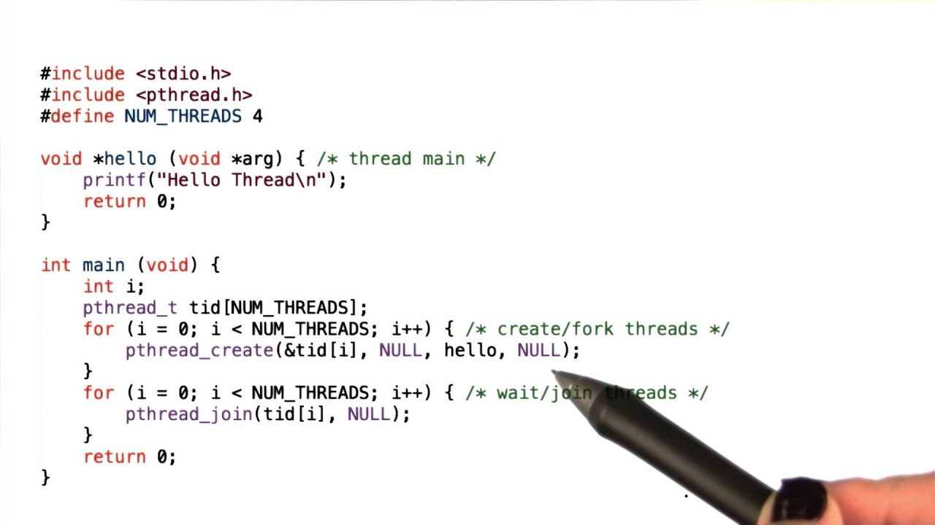
Thread Example

Slide 20
#include<pthread.h> #include <stdio.h>
/* Producer/consumer program illustrating conditional variables */ /* Size of shared buffer */ #define BUF_SIZE 3
int buffer[BUF_SIZE]; /* shared buffer */
int add=0; /* place to add next element */
int rem=0; /* place to remove next element */
int num=0; /* number elements in buffer */
pthread_mutex_t m=PTHREAD_MUTEX_INITIALIZER; /* mutex lock for buffer */
pthread_cond_t c_cons=PTHREAD_COND_INITIALIZER; /* consumer waits on this cond var */
pthread_cond_t c_prod=PTHREAD_COND_INITIALIZER; /* producer waits on this cond var */
void *producer(void *param);
void *consumer(void *param);
main (int argc, char *argv[])
{ pthread_t tid1, tid2; /* thread identifiers */
int i; /* create the threads; may be any number, in general */
if (pthread_create(&tid1,NULL,producer,NULL) != 0) {
fprintf (stderr, "Unable to create producer thread\n"); exit (1); }
if (pthread_create(&tid2,NULL,consumer,NULL) != 0) {
fprintf (stderr, "Unable to create consumer thread\n"); exit (1);
}
/* wait for created thread to exit */
pthread_join(tid1,NULL);
pthread_join(tid2,NULL);
printf ("Parent quiting\n"); }
}

Slide 21
/* Produce value(s) */
void *producer(void *param)
{
int i;
for (i=1; i<=20; i++) {
/* Insert into buffer */
pthread_mutex_lock (&m);
if (num > BUF_SIZE) exit(1); /* overflow */
while (num == BUF_SIZE) /* block if buffer is full */
pthread_cond_wait (&c_prod, &m);
/* if executing here, buffer not full so add element */
buffer[add] = i;
add = (add+1) % BUF_SIZE;
num++;
pthread_mutex_unlock (&m);
pthread_cond_signal (&c_cons);
printf ("producer: inserted %d\n", i); fflush (stdout);
}
printf ("producer quiting\n"); fflush (stdout);
}

Slide 22
/* Consume value(s); Note the consumer never terminates */
void *consumer(void *param)
{
int i;
while (1) {
pthread_mutex_lock (&m);
if (num < 0) exit(1); /* underflow */
while (num == 0) /* block if buffer empty */
pthread_cond_wait (&c_cons, &m);
/* if executing here, buffer not empty so remove element */
i = buffer[rem];
rem = (rem+1) % BUF_SIZE;
num--;
pthread_mutex_unlock (&m);
pthread_cond_signal (&c_prod);
printf ("Consume value %d\n", i); fflush(stdout);
}
}

Slide 23
Thank you

